Slide 1

UROP PROJECT
HEART ATTACK PREDICTION
DONE BY:
N.VAISHNAVI (AP19110010487)
K.GEETIKA (AP19110010123)
K.LAHARI (AP19110010548)
G.SUSHMA (AP19110010551)

Slide 2


Slide 3
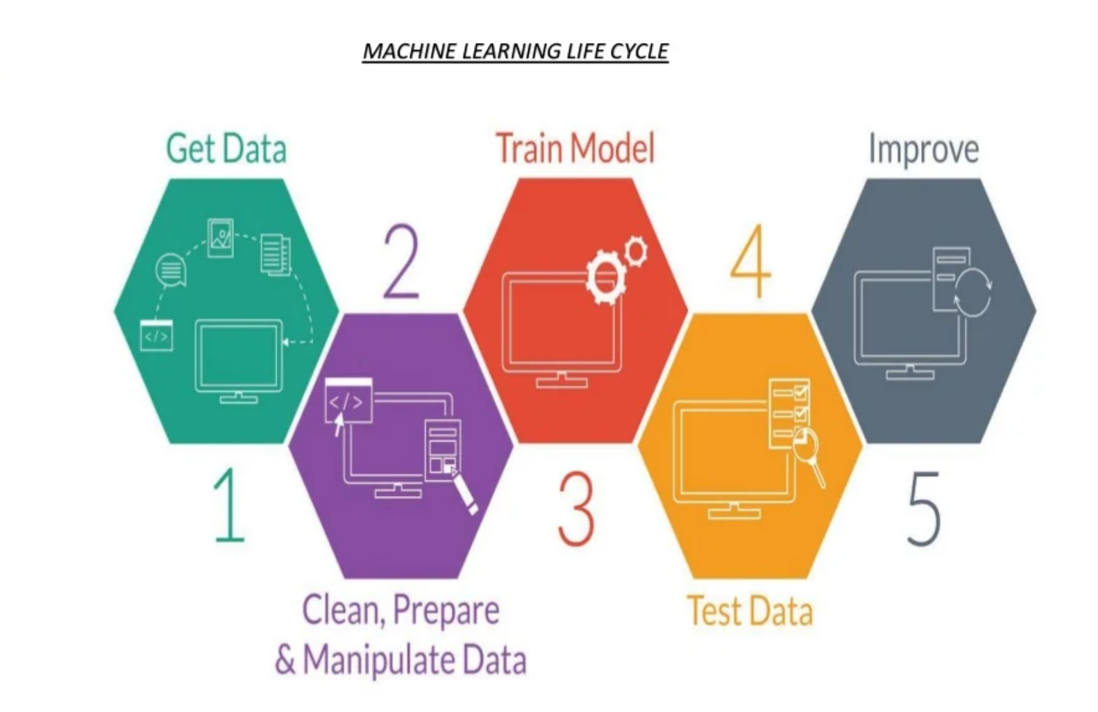

Slide 4
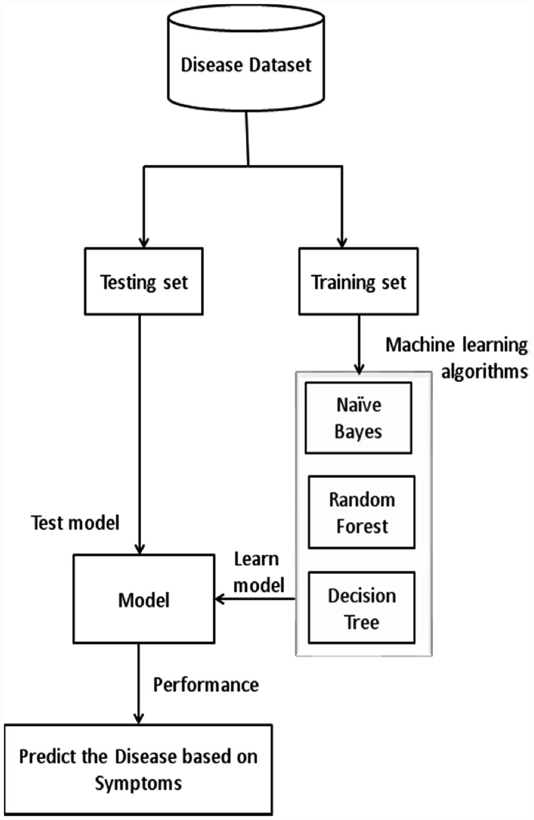


Slide 5
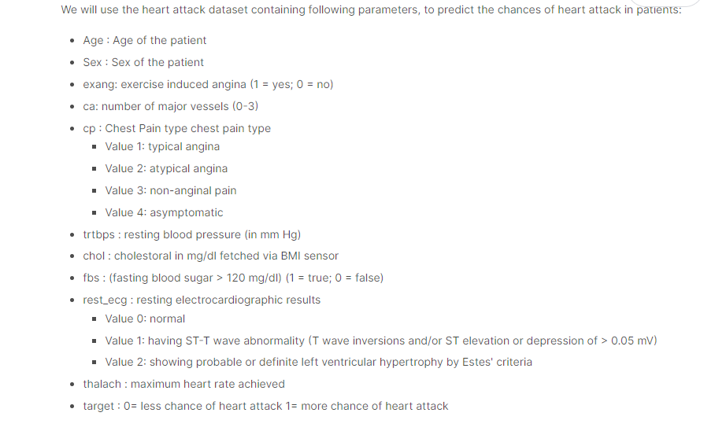

Slide 6
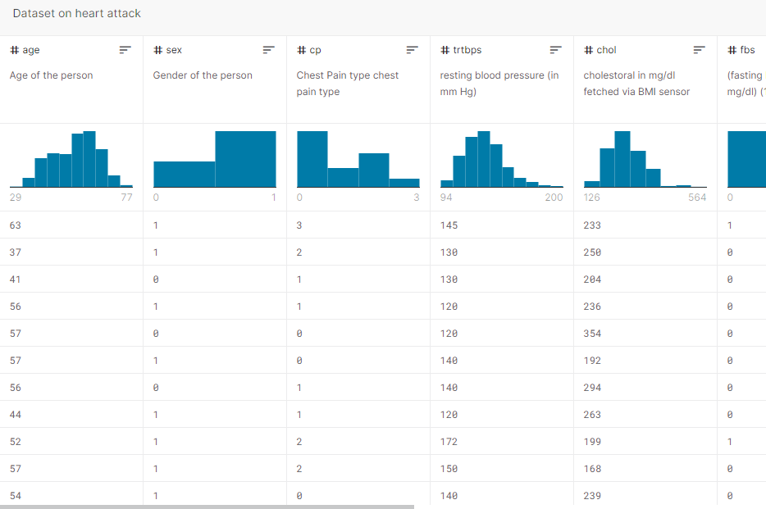

Slide 7


